Slide 1

Diabetic Disease Prediction using Machine Learning
Submitted by
Yaswitha Sai Atluri
Submitted to
Exposys Data Labs
Data Science Intern

Slide 2
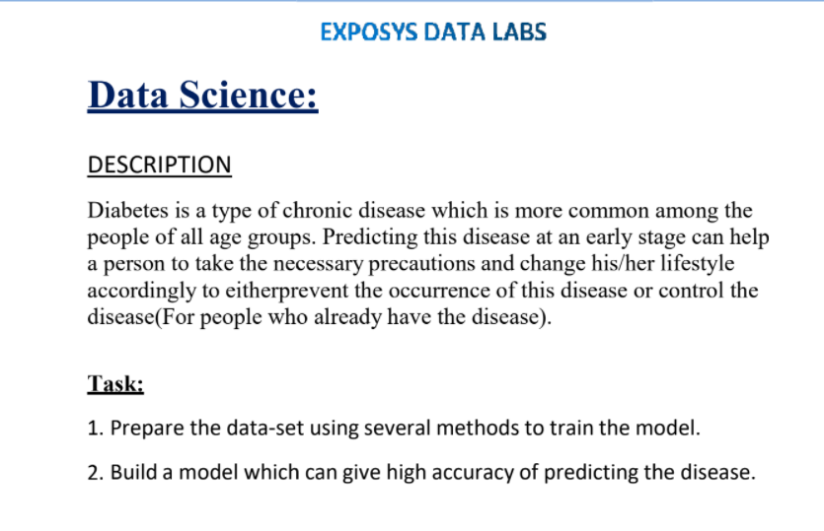
Task

Slide 3
Overview
Introduction
Objective of the Project
Related Works
Proposed Diabetic prediction model
Block Diagram of proposed Diabetic Prediction model
Methodology / Algorithm Description
Description about Software Unit
Advantages
Applications
Summary
References

Slide 4
Introduction
Diabetes is one of the chronic diseases in the world, 246 million people are inflicted by this disease and according to a World Health Organisation (WHO) report, this figure will increase to 380 million sufferers by 2025.
Many other debilitating and critical health issues may further develop if this disease is not diagnosed or remain unidentified.
Machine Learning (ML) techniques are now being used in various fields like education, healthcare, business, recommendation system, etc.
Healthcare data is complex and high in dimensionality and contains irrelevant information - due to this, the prediction accuracy is low.
The Pima Indians Diabetes Dataset was used in this research, it consisted of 768 records. Firstly, the missing values are replaced by the median followed by Linear Discriminant Analysis.

Slide 5
Introduction
This dataset is originally from the National Institute of Diabetes and Digestive and Kidney Diseases.
The objective of the dataset is to diagnostically predict whether or not a patient has diabetes, based on certain diagnostic measurements included in the dataset.
Several constraints were placed on the selection of these instances from a larger database. In particular, all patients here are females at least 21 years old of Pima Indian heritage.
Using the Python programming language, feature selection techniques is applied in combination with the following classification algorithms: Support Vector Machine (SVM), K-Nearest Neighbors , Naive Bias.
The aim of this project is to compare the different classification algorithms in order to predict diabetes in patients more accurately

Slide 6
Objective of the Project
Healthcare data is complex and high in dimensionality and contains irrelevant information - due to this, the prediction accuracy is low.
The Pima Indians Diabetes Dataset was used in this research, it consisted of 768 records.
Machine learning techniques can find the risky factors of diabetes and reasonable threshold of physiological parameters to unearth hidden knowledge from a huge amount of diabetes-related data, which has a very important significance for diagnosis and treatment of diabetes.
So this project provides a survey of machine learning techniques that has been applied to diabetes data screening and diagnosis of the disease.
In this project, conventional machine learning techniques are described in early screening and diagnosis of diabetes.

Slide 7
Related Works
Mitushi Soni , Dr. Sunita Varma [1] designed and implemented Diabetes Prediction Using Machine Learning Methods and Performance Analysis of that methods and it has been achieved successfully. The proposed approach uses various classification and ensemble learning method in which SVM, Knn, Random Forest, Decision Tree, Logistic Regression and Gradient Boosting classifiers are used. And 77% classification accuracy has been achieved. The Experimental results can be asst health care to take early prediction and make early decision to cure diabetes and save humans life.
K.VijiyaKumar et al. [2] proposed random Forest algo- rithm for the Prediction of diabetes develop a system which can perform early prediction of diabetes for a patient with a higher accuracy by using Random Forest algorithm in ma- chine learning technique. The proposed model gives the best results for diabetic prediction and the result showed that the prediction system is capable of predicting the diabetes disease effectively, efficiently and most importantly, instantly.

Slide 8
Related Works
Nonso Nnamoko et al. [5] presented predicting diabetes onset: an ensemble supervised learning approach they used five widely used classifiers are employed for the ensembles and a meta-classifier is used to aggregate their outputs. The results are presented and compared with simi- lar studies that used the same dataset within the literature. It is shown that by using the proposed method, diabetes onset prediction can be done with higher accuracy. Tejas
N. Joshi et al. [4] presented Diabetes Prediction Using Machine Learning Techniques aims to predict diabetes via three different supervised machine learning methods including: SVM, Logistic regression, ANN. This project pro- poses an effective technique for earlier detection of the diabetes disease.
Deeraj Shetty et al. [7] proposed diabe- tes disease prediction using data mining assemble Intelli- gent Diabetes Disease Prediction System that gives analysis of diabetes malady utilizing diabetes patients database. In this system, they propose the use of algorithms like Bayesian and KNN (K-Nearest Neighbor) to apply on diabetes patients database and analyze them by taking various attributes of diabetes for prediction of diabetes disease.

Slide 9
Related Works
Muhammad Azeem Sarwar et al. [8] proposed study on prediction of diabetes using machine learning algorithms in healthcare they applied six different machine learning algo- rithms Performance and accuracy of the applied algorithms is discussed and compared.
Comparison of the different machine learning techniques used in this study reveals which algorithm is best suited for prediction of diabetes. Diabetes Prediction is becoming the area of interest for researchers in order to train the program to identify the patient are diabetic or not by applying proper classifier on the dataset.
Based on previous research work, it has been observed that the classification process is not much improved. Hence a system is required as Diabetes Prediction is important area in computers, to handle the issues identified based on previous research.

Slide 10
Proposed Diabetic prediction model
Here we collect the data ( in this case we are using PIMA Indians Diabetes Data set is taken) , we do some preprocessing techniques like data cleaning , missing values insertion , Feature selection , after that cleaning the data and analyzing it .
After the pre processing steps we spilt the data set into Train and Test data sets (80% and 20% respectively).
After spiltting the data set , we apply machine learning algorithms to it and predict the accuracy of that algorithms and detect the most accurate one.
This is most important phase which includes model building for prediction of diabetes.
In this we have implemented various machine learning algorithms such as KNN, SV , Naive Bias for diabetes prediction.

Slide 11
Block Diagram of proposed Diabetic Prediction model
Data collection
Data Pre Processing
Data preparation and Feature selection
Data Cleaning and Data Analysis
Training Set
Test Set
K-NN
SVM
Naive bias
ML Model
Predicted Outcome

Slide 12
Methodology / Algorithm Description
Step 1: Import required libraries, Import diabetes dataset.
Step 2: Pre-process data to remove missing data.
Step 3: Perform percentage split of 80% to divide dataset as Training set and 20% to Test set.
Step 4: Select the machine learning algorithm i.e. K- Nearest Neighbor, Support Vector Machine, Decision Tree, Logistic regression, Random Forest and Gradient boosting algorithm.
Step 5: Build the classifier model for the mentioned machine learning algorithm based on training set.

Slide 13
Methodology / Algorithm Description
Step 6: Test the Classifier model for the mentioned machine learning algorithm based on test set.
Step 7: Perform Comparison Evaluation of the experimental performance results obtained for each classifier.
Step 8: After analyzing based on various measures conclude the best performing algorithm

Slide 14
Description about Software Unit
Anaconda Navigator -Jupyter notebook.
Kaggle notebook for dataset-PIMA Indian diabetes dataset.
Libraries:
Pandas
Numpy
ScikitLearn.
Seaborn.

Slide 15
Algorithms used
Support Vector Machine:
Support Vector Machine also known as SVM which is a supervised machine learning algorithm.
SVM is most popular classification technique. SVM creates a hyper plane that separate two classes.
It can create a hyper plane or set of hyper plane in high dimensional space. This hyper plane can be used for classification or regression also.
SVM differentiates instances in specific classes and can also classify the entities which are not supported by data.
Separation is done through hyper plane performs the separation to the closest training point of any class.

Slide 16
Algorithms used
K Nearest Neighbor :
KNN is also a supervised machine learning algorithm. KNN helps to solve both the classification and regression problems.
KNN is lazy prediction technique. KNN assumes that similar things are near to each other.
Many times data points which are similar are very near to each other.KNN helps to group new work based on similarity measure.
KNN algorithm record all the records and classify them according to their similarity measure.
For finding the distance between the points uses tree like structure. To make a prediction for a new data point, the algorithm finds the closest data points in the training data set its nearest neighbors.

Slide 17
Algorithms used
Naive Bias:
Naive Bayes classifiers are a collection of classification algorithms based on Bayes' Theorem.
It is not a single algorithm but a family of algorithms where all of them share a common principle, i.e. every pair of features being classified is independent of each other.
Naive Bayes uses a similar method to predict the probability of different class based on various attributes.
This algorithm is mostly used in text classification and with problems having multiple classes.

Slide 18
Advantages and Applications
When detected early, the patient may not only delay but even prevent progression to diabetes.
Disease prevention is significantly less expensive than the treatment of frank hyper glycemia and diabetic complications.
The primary intervention for pre-diabetes, as with type 2 diabetes, is lifestyle modification.
It can be applied in the fields of Medicine
Personalized Medicine prescription
Fast and Robust and it can give the results within seconds
Diabetic Prediction mobile App’s
Automatic Treatment or Recommendation
Improving Performance

Slide 19
Summary
The main aim of this project was to design and implement Diabetes Prediction Using Machine Learning Methods and Performance Analysis of that methods and it has been achieved successfully.
In this project, various machine learning algorithms are applied on the dataset and the classification has been done using various algorithms.
The proposed approach uses various classification and ensemble learning method in which SVM, KNN and Naive Bias classifiers are used with accuracy of 81.8%, 81.8% and 79.22% respectively.

Slide 20
Summary
It is clear that the model improves accuracy and precision of diabetes prediction with this dataset compared to existing dataset.
Further this work can be extended to find how likely non diabetic people can have diabetes in next few years.
The Experimental results can be assist health care to predict and make early decision to cure diabetes and save humans life.
In future we can also develop and app using flask and can predict the chances of having diabetes by simply just providing the values of the glucose, insulin, age and BMI values

Slide 21
REFERENCES
Mitushi Soni , Dr. Sunita Varma, “ Diabetes prediction using machine learning techniques “. IJERT, 2278-0181
Debadri Dutta, Debpriyo Paul, Parthajeet Ghosh, "Analyzing Feature Importances for Diabetes Prediction using Machine Learning". IEEE, pp 942-928, 2018.
K.VijiyaKumar, B.Lavanya, I.Nirmala, S.Sofia Caroline, "Random Forest Algorithm for the Prediction of Diabetes ".Proceeding of International Conference on Systems Compu- tation Automation and Networking, 2019.
Md. Faisal Faruque, Asaduzzaman, Iqbal H. Sarker, "Perfor- mance Analysis of Machine Learning Techniques to Predict Diabetes Mellitus". International Conference on Electrical, Computer and Communication Engineering (ECCE), 7-9 Feb- ruary, 2019.

Slide 22
REFERENCES
5. Tejas N. Joshi, Prof. Pramila M. Chawan, "Diabetes Prediction Using Machine Learning Techniques".Int. Journal of Engineer- ing Research and Application, Vol. 8, Issue 1, (Part -II) Janu- ary 2018, pp.-09-13
Nonso Nnamoko, Abir Hussain, David England, "Predicting Diabetes Onset: an Ensemble Supervised Learning Approach ". IEEE Congress on Evolutionary Computation (CEC), 2018.
Deeraj Shetty, Kishor Rit, Sohail Shaikh, Nikita Patil, "Diabe- tes Disease Prediction Using Data Mining ".International Con- ference on Innovations in Information, Embedded and Com- munication Systems (ICIIECS), 2017.
Nahla B., Andrew et al,"Intelligible support vector machines for diagnosis of diabetes mellitus. Information Technology in Biomedicine", IEEE Transactions. 14, (July. 2010), 1114-20.
A.K., Dewangan, and P., Agrawal, Classification of Diabetes Mellitus Using Machine Learning Techniques, International Journal of Engineering and Applied Sciences, vol. 2, 2015.

